Slide 1
Lecture 2
Single s/c boundary studies

Slide 2
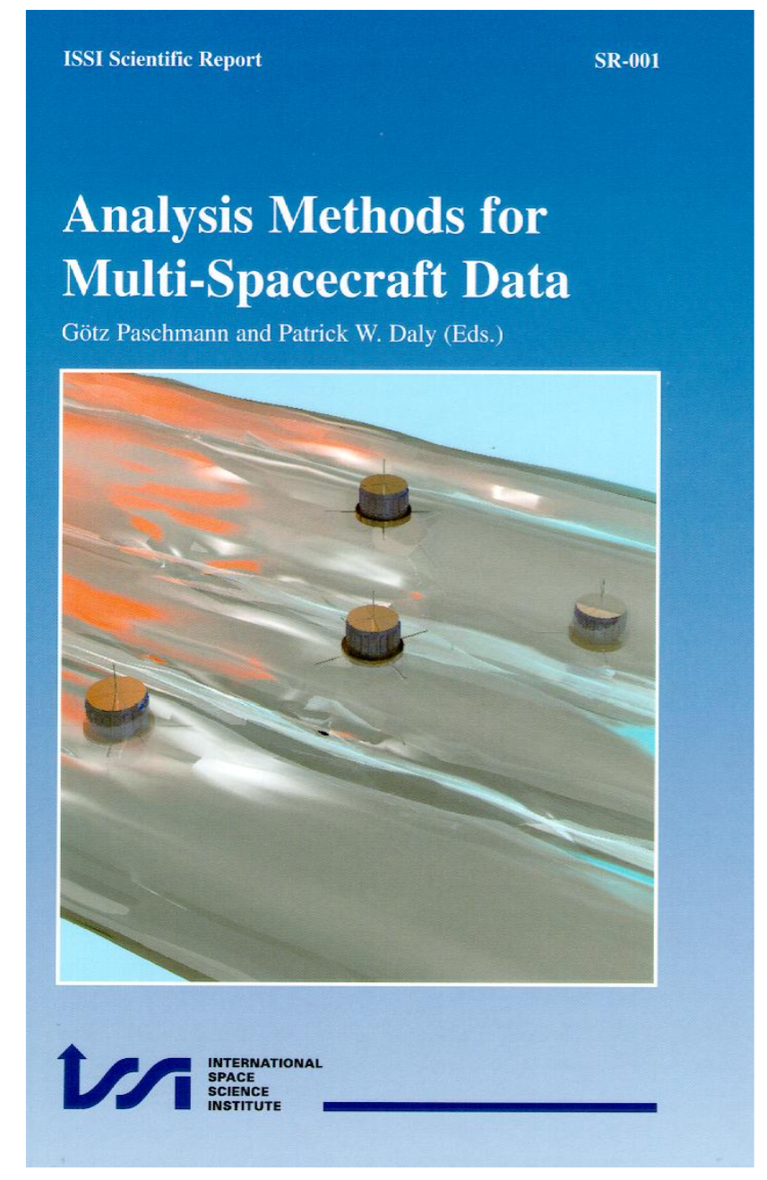
1st edition 2000 www
Revisited www, links to many
Publications using different methods

Slide 3
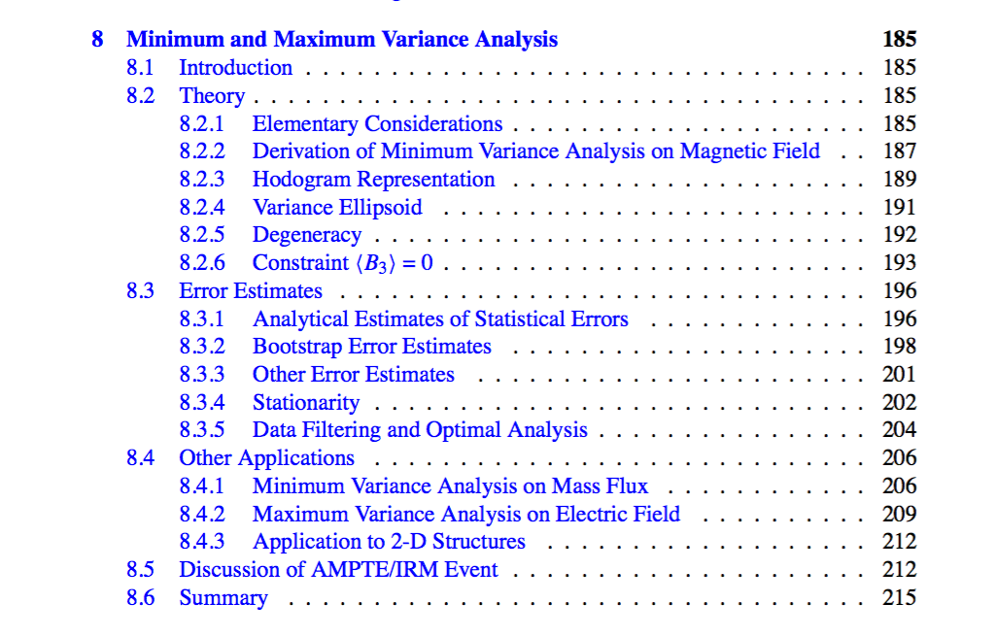
Minimum/Maximums Variance Analysis

Slide 4
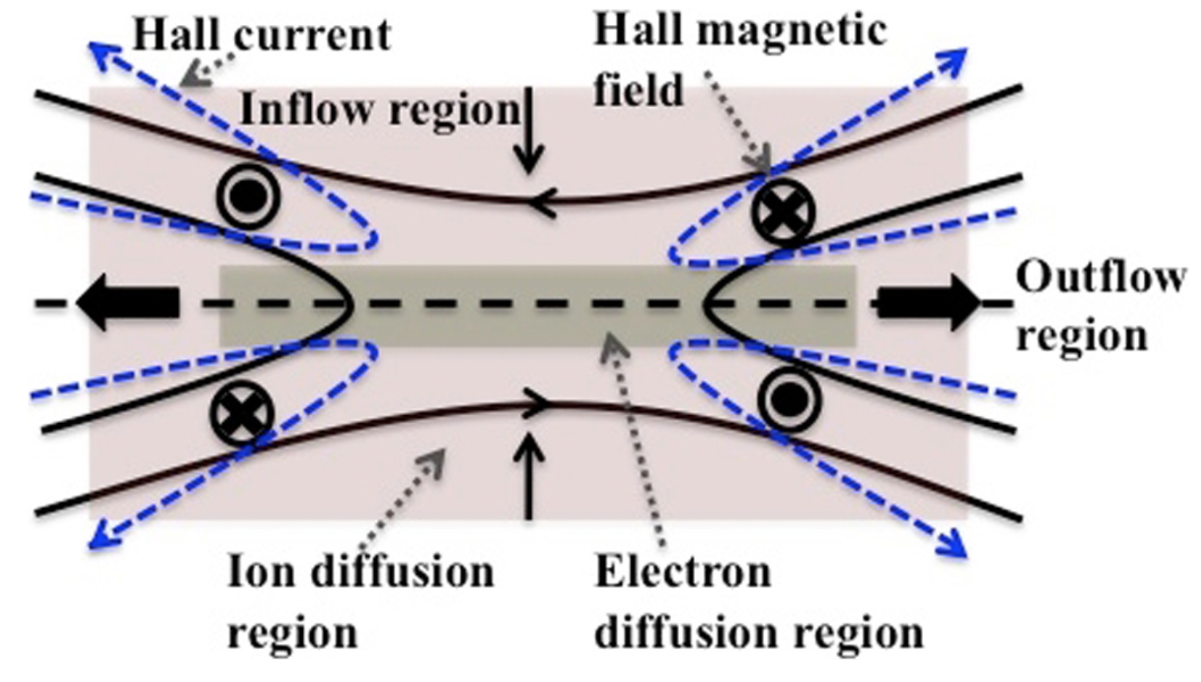
Reconnection diffusion region
[Borg et al, 2012, Ann Geo]

Slide 5
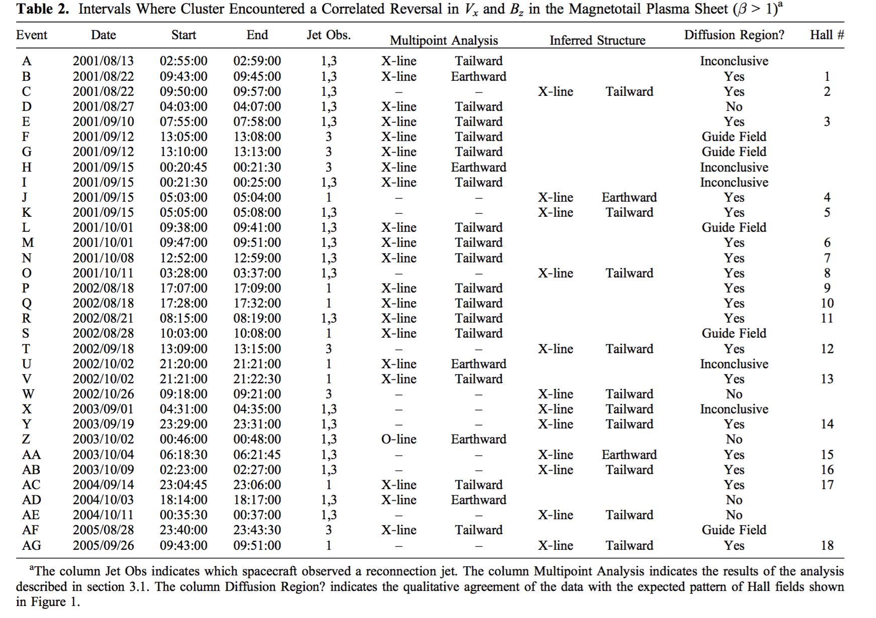
Magnetotail diffusion regions (Eastwood et al., 2010, JGR)

Slide 6
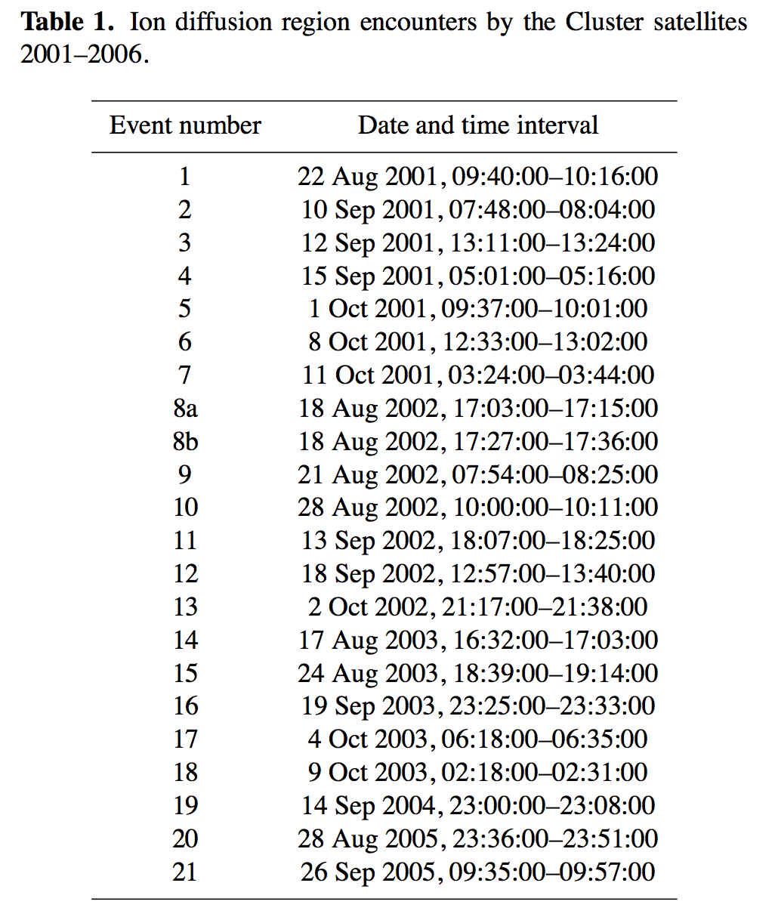
Magnetotail diffusion regions (Borg et al., 2012, AnnGeo)

